Slide 1

Handwritten Character Recognition using Machine Learning (CNN algorithm)
Department of Artificial Intelligence
Supervisor: Mr.Vikas Tripathi, Ms Divya Raj
Group Members
Name of Member | Roll Number | Role
Rakshit Sangal | 2001331520085 | Validation and Verification
Prerna Dobriyal | 2001331520084 | Dataset Preparation

Slide 2

Index
Introduction
Problem Statement
Existing System
Proposed Methodology
Feasibility Study
Modules
Use case and Flow Chart
Hardware and Software Requirements
Snapshots
Conclusion and Future Scope
References

Slide 3
Introduction
Handwritten character recognition is an area of pattern recognition which defines an ability of a machine to analyze patterns and identify the character.
Pattern recognition is the science of making inferences from perceptual data based on either a priori knowledge or on statistical information .
Handwritten Character recognition is the technique or ability of the computer to receive interpret intelligible handwriting from source such as paper document or photograph
The basic function of pattern recognition system is to detect and extract common features from the patterns describing the objects that belong to the same pattern classes and to recognize the pattern and classify it as a member of the pattern class under consideration. Since last few decades and advancement in technology, computers interact more effectively with humans and with the natural world e.g. speech recognition, handwritten recognition, gesture recognition etc. However, Humans are outperforming far better than machines in recognizing patterns.

Slide 4
Literature Survey/Existing System
Gaurav Kumar,Pradeep Kumar Bhatia(2013) | This paper deals with the various preprocessing techniques involved in character recognition system with different kind of images ranges from simple handwritten form based documents and documents containing colored and complex background and varied intensities. | Only using noise removal we cannot completely preprocess an image. Therefore all image enhancement techniques have to be applied for accuracy in preprocessing system. Preprocessed image can be used in feature extraction phase and then in neural network phase. | Even applying all these techniques we cannot obtain the 100% accuracy in a preprocessing system | It is found that major activities in a typical preprocessing system are image enhancements, noise removal, contrast adjustment, binarization, normalization, segmentation.

Slide 5
Writer | Abstract | Conclusion | Limitation | Result
Ridhi Jindal Dr.Sonia Vatta (International Journal of Advance research and Innovation in Technology) Volume 1,Issue 1,October 2014 | This paper presents a study on SIFT which is method for extracting features from images that can be used to perform reliable matching between different views of an object or scene | Highly distinctive Scale and rotation invariant Can be computed fast and efficiently | Partially invariant to changes in illumination Partially invariant to 3D camera viewpoint | This algorithm can be used in object recognition Robot localization and mapping Panorama stitching 3D scene modeling

Slide 6
Neha Sharma Vibhor Jain Anju Mishra (international conference on computational intelligence and data science 2018 | This paper presents an empirical analysis of the performance of popular convolution neural networks. This paper is about testing the accuracy of different CNN on static image and video feeds | The work analyzed the prediction accuracy of three different CNN on most popular training and test datasets namely CIFAR10 and CIFAR100 | It is important to note that complex frames often create confusion for the network to detect and recognize the scene The hardware requirement may no allow the network to be trained on the normal desktop | More the numbers of the layer more will be the training and higher will be the accuracy

Slide 8
Problem Statement
To handwritten character recognition from an image using CNN algorithm
In this project our main aim is to take an input from the user in the form of offline mode that is scanned images
We will train our software from the inputs taken from the users and prepare a training data set
Then if the input is image we will perform some preprocessing, segmentation
And then by using the CNN model we will try to recognize the digits alphabets letter etc to achieve maximum accuracy possible

Slide 9
Methodology
The steps of proposed method are as follows:
Creating training and testing datasets: the super classes images used for training is resized, and the dataset is divided into two categories i.e. training and validating data sets
Modifying CNNs network: replace the last three layers of the network with fully connected layer, a soft-max layer and a classification output layer. Set the final fully connected layer to have same sizes as the number of classes in the training datasets. Increase the learning rate factors of the fully connected layer to train network faster
Train the network: set the training options including learning rate mini batch size and validation data according to GPU specifications of the system. Train the network using the training data
Test the accuracy of the network: Classify the validation images using the fine tuned network and calculate the classification accuracy. Similarly testing the fine tune network on real time video feeds for accuracy results
Extracting the Characters: Now the characters are extracted from the scanned image

Slide 10
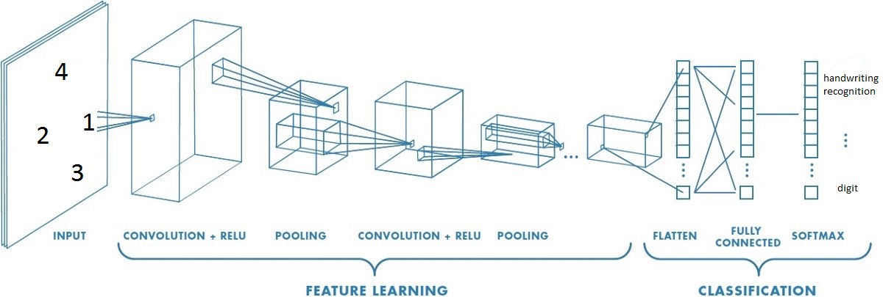
Architecture of CNN:

Slide 11
How it works:
Neural Networks receive an input, and transform it through a series of hidden layers.
Each hidden layer is made up of a set of neurons, where each neuron is fully connected to all neurons in the previous layer.
Neurons in a single layer function completely independently.
The last fully-connected layer is called the "output layer“.

Slide 12
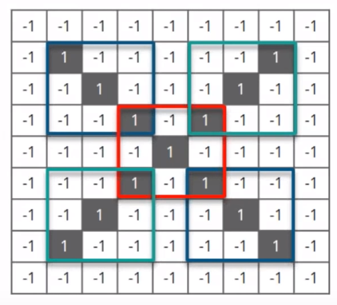
Steps involved CNN:
Feature pixel matrix
Step1-line up the feature and the image
Step2-multiply the each image pixel by corresponding feature pixel
Step3-add them up
Step4-divide by total number of pixel in feature
Image pixel matrix

Slide 13
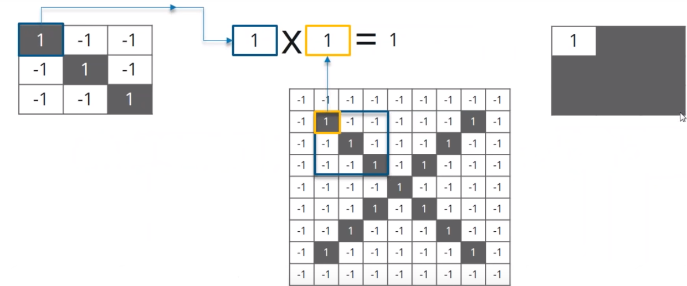
Step 2:Multiply each image pixel by corresponding feature pixel
Output pixel
Feature pixel
Image pixel

Slide 14
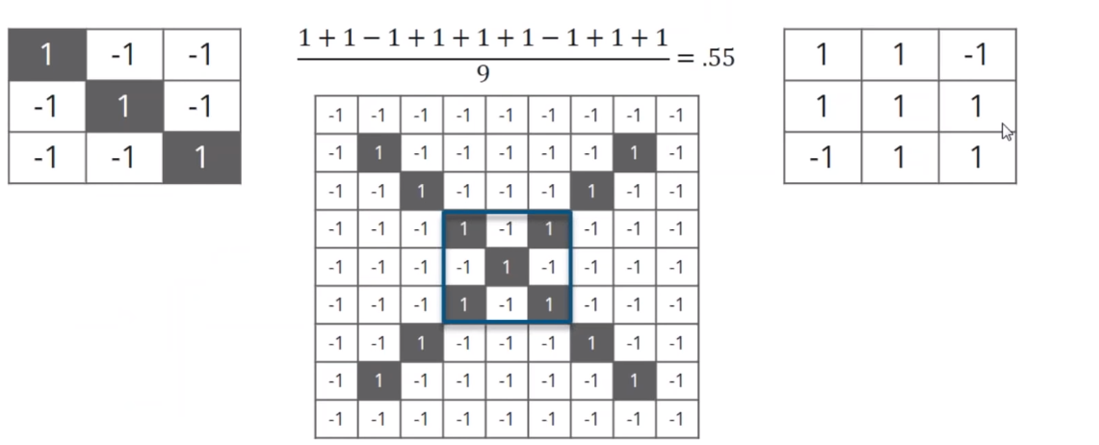
Step 3:Add all the pixel of the output after multiplication
Step4:Divide by total number of pixel in features

Slide 15
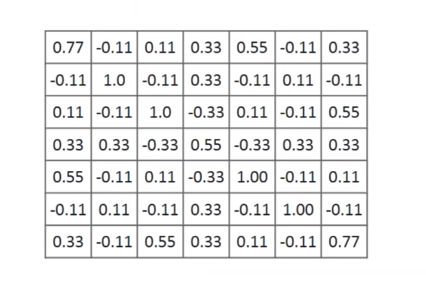
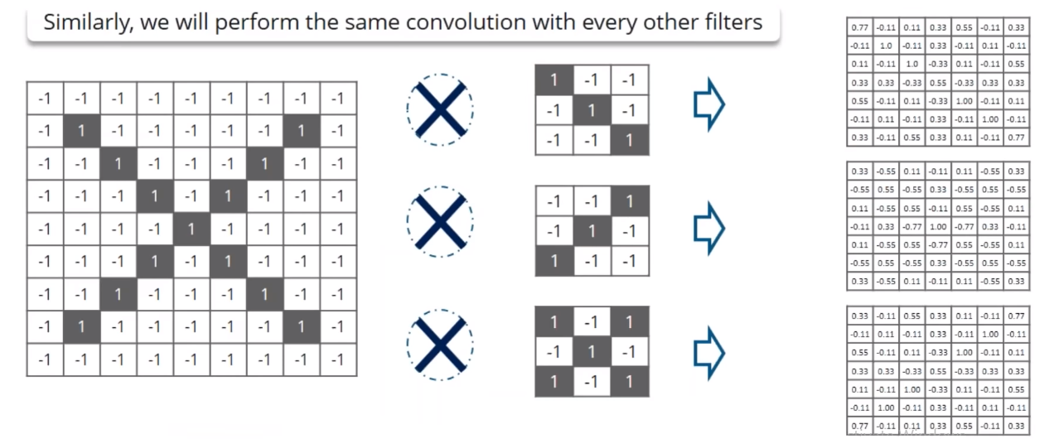
After performing all above process we will get following matrix from one feature or
Filter similarly we will perform same process from all other feature to extract features
Image pixel
Feature pixels
Extracted feature pixel

Slide 16
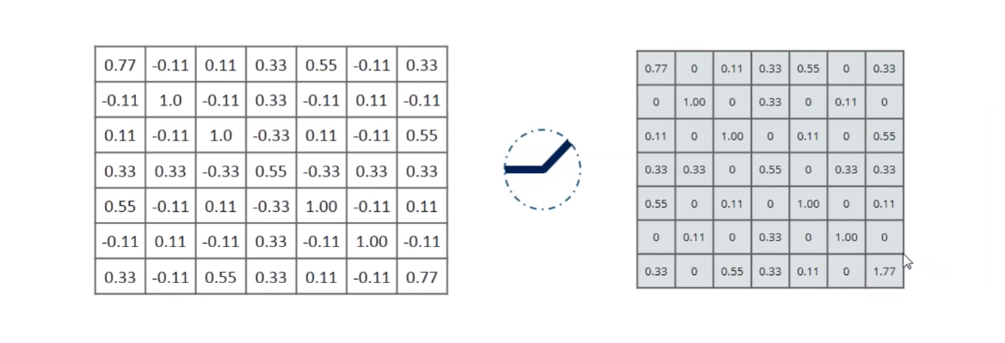
ReLU layer:

Slide 17
Pooling Layer:
Pick a window size(usually 2 to 3)
Pick a stride(usually 2)
Walk your windows across your filtered images
From each window, take maximum value

Slide 18
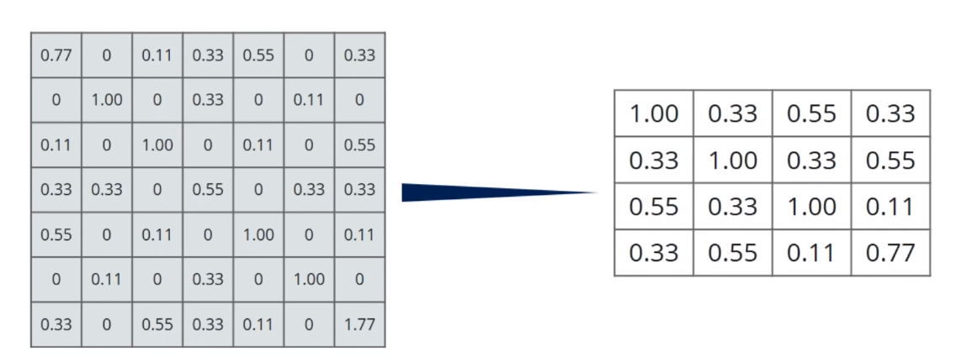

Slide 19
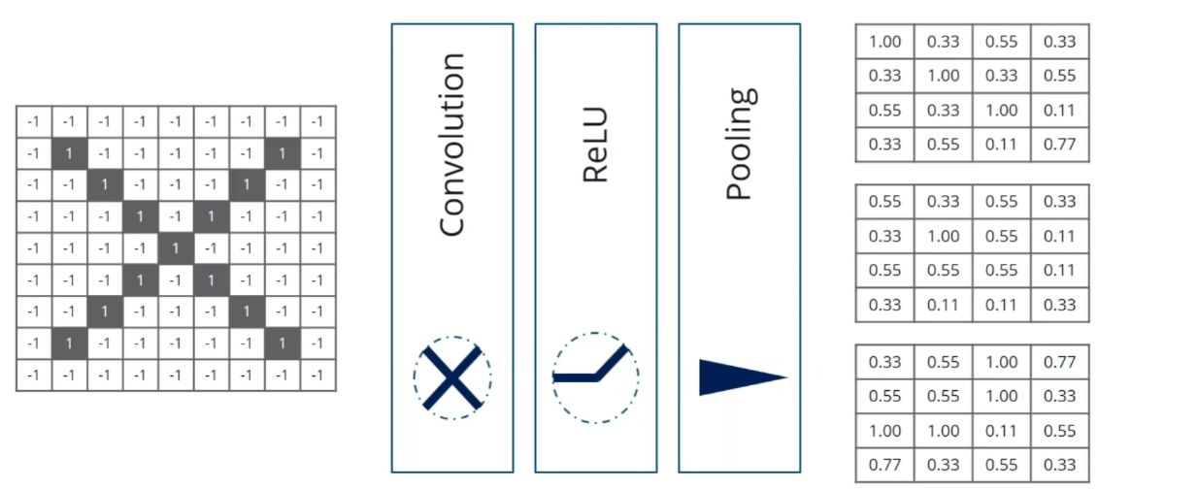
Stacking up all the layers:

Slide 20
CLASSIFICATION:
The last three layers of the network with fully connected layer, a soft-max layer and a classification output layer. Set the final fully connected layer to have same sizes as the number of classes in the training datasets. Increase the learning rate factors of the fully connected layer to train network faster.
Fully Connected Layer: The fully connected layer which takes the high-level filtered images
Soft-max layer: The purpose of the soft-max classification layer is simply to transform all the net activations in your final output layer to a series of values that can be interpreted as probabilities. Finding the most probable
Classification Output Layer: The soft-max function can also be used as a classifier for the final output because it finds the most probable output.

Slide 21
Feasibility Study:
The handwritten character recognition is very important application of machine learning Offline handwriting text recognition system. The CNN provide more accuracy almost comparable to human beings The NN training is feasible on CPU but more complex neural network will require more CPU capability minimum of 8GB RAM and external GPU will make the processing fast and more complex may be solved more easily and will provide more accurate results.
The handwriting detection is used at many places like
Reducing the more and more paper works
Preserving old documents
Cheating detection
Virtual notes making
More organized document in government organization and educational organizations

Slide 22
Module 1:Preprocessing of Image
Scanned image
Grey scaling and Binarisation
Inverting binary image for blobs

Slide 23
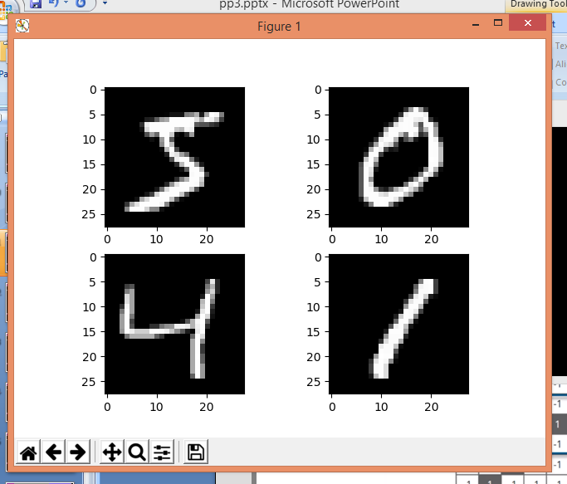
Extracted features

Slide 24
Module 2:Feature Extraction of Characters from Image
Labeling and boxing of extracted characters
Cropping Reshaping and Resizing

Slide 25
Module 3:Training the Network and Testing

Slide 26
This is the trained network Using CNN
It is important to note that the network would not be immune to noisy hand written input if it is not trained properly. Or in other words, if the network is not trained with noisy set of characters along with the ideal set of characters, the network will not show the correct output every time. In fact all the handwritten characters remain irregular. So to make the network identify irregular shaped characters properly we must have to train the network with a noisy set of characters. In this case a set of noisy characters is obtained by adding some noise programmatically with some non-zero value of mean and variance.

Slide 27
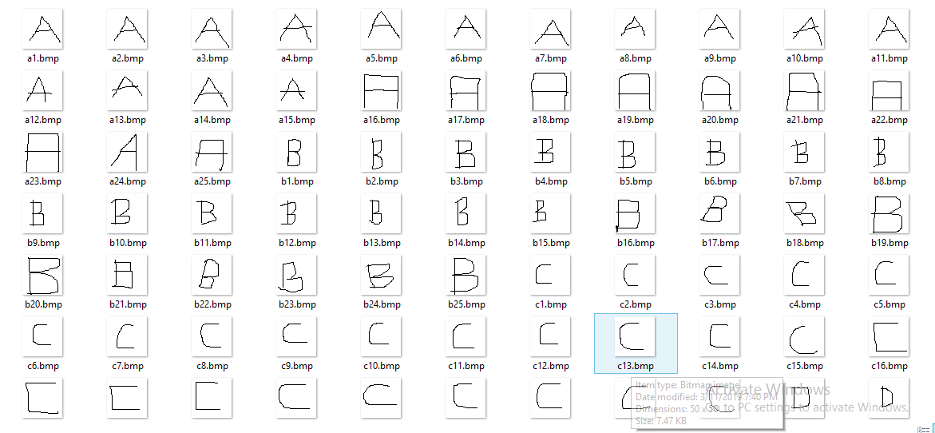
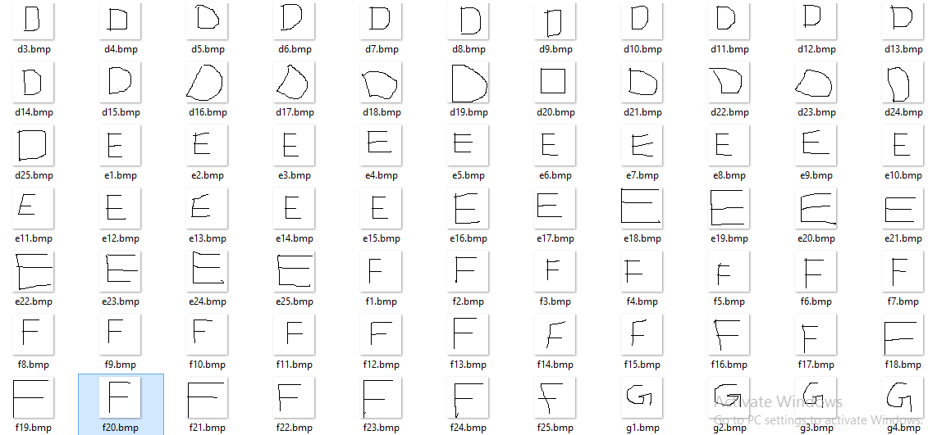
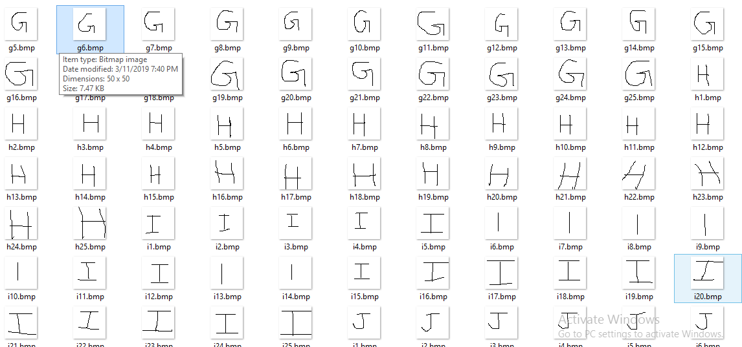
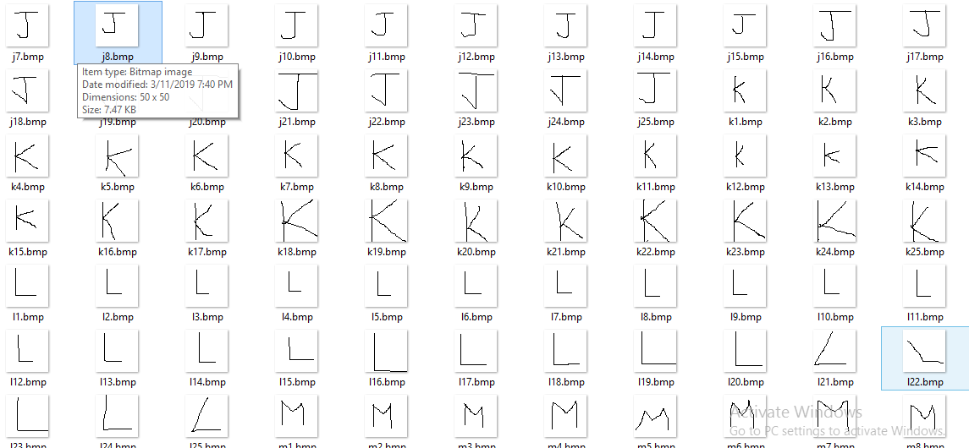
Screenshots of Datasets used:

Slide 28
Dataset used: The dataset used is the MNIST database of handwritten digits. It consists of a training set of 60,000 examples, and a test set of 10,000 examples. The digits have been size-normalized and centered in a fixed-size image. The images are of size 28*28 pixels. It is a good database for people who want to try learning techniques and pattern recognition methods on real-world data while spending minimal efforts on preprocessing and formatting.
The dataset was constructed from a number of scanned document dataset available from the National Institute of Standards and Technology (NIST). This is where the name for the dataset comes from, as the Modified NIST or MNIST dataset.
Images of digits were taken from a variety of scanned documents, normalized in size and centered. This makes it an excellent dataset for evaluating models, allowing the developer to focus on the machine learning with very little data cleaning or preparation required
Each image is a 28 by 28 pixel square (784 pixels total). A standard spit of the dataset is used to evaluate and compare models, where 60,000 images are used to train a model and a separate set of 10,000 images are used to test it

Slide 29
Flow Chart:
START
Take scanned images as input data
Train Network
Preprocessing
NO
Feature Extraction
Stroke Identification
YES
Handwritten Character Match with Training Dataset (CNN)
Character Recognition
END

Slide 30
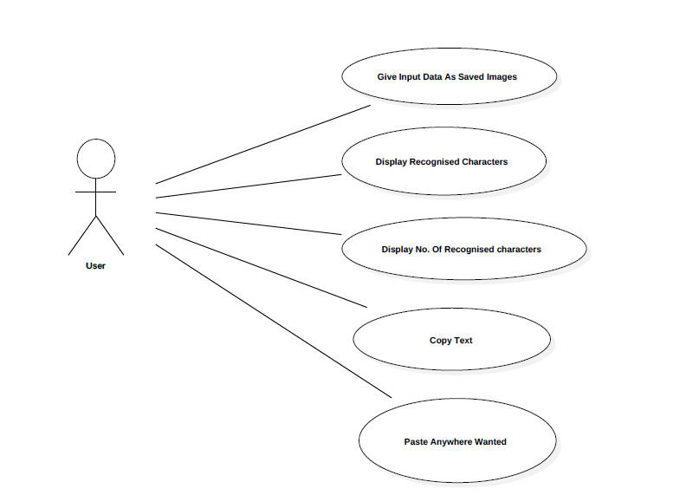
Use Case:

Slide 31
Hardware and Software requirements:
Min-Hardware requirements
8GB RAM or higher
Hard drive 500GB or higher
CPU core i5
External GPU
Software requirements
Python3 or above
Python libraries and pip package manager
MNIST datasets
MATLAB

Slide 32
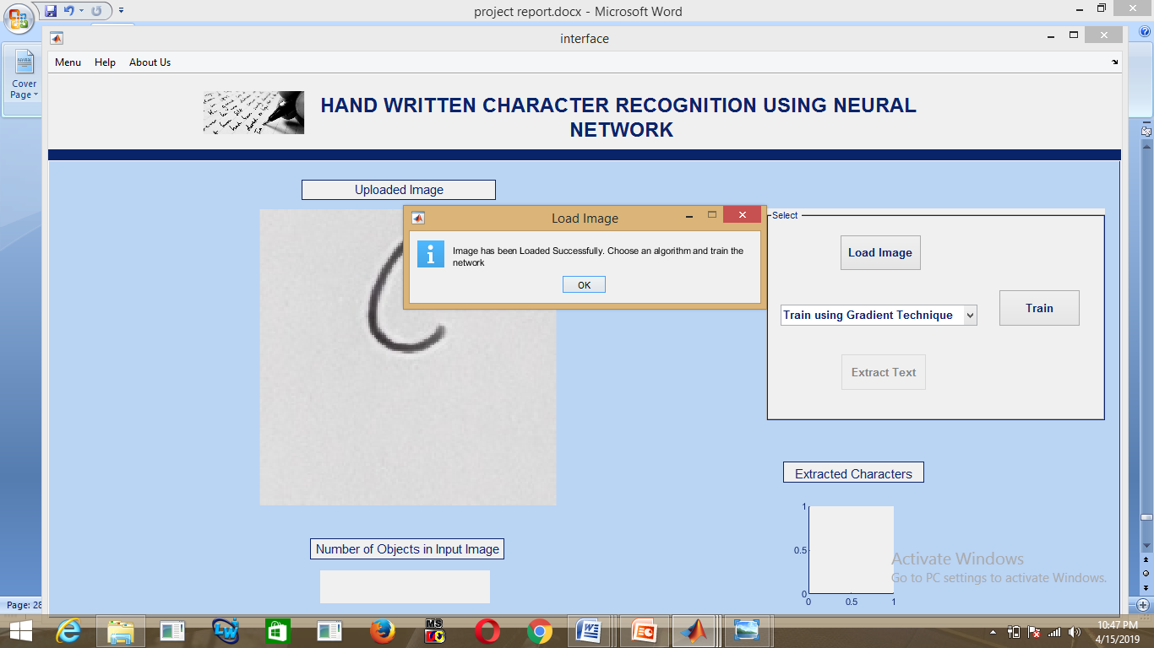
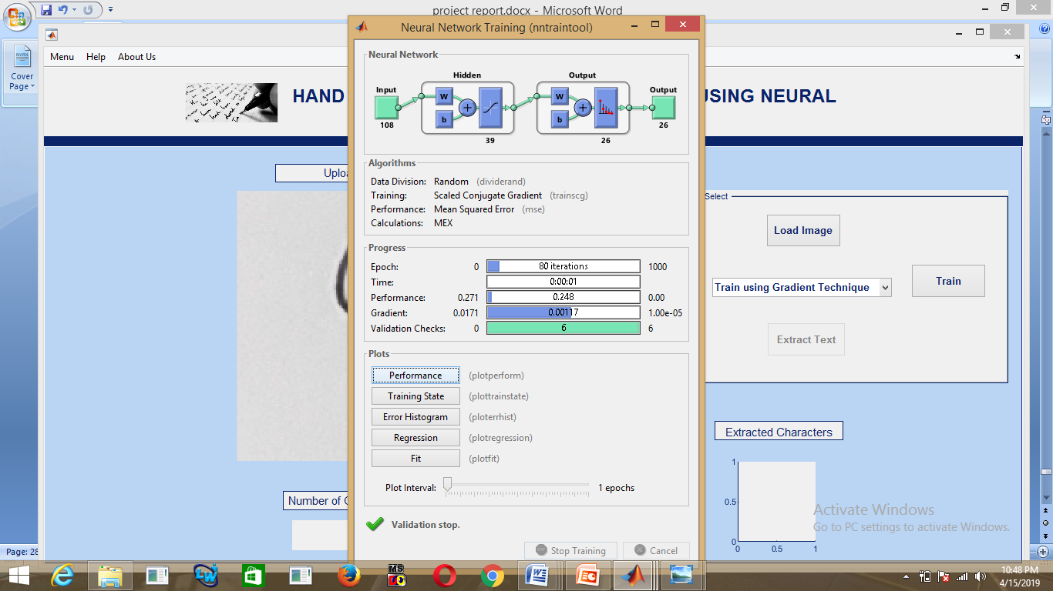
Screenshots of processing:
uploading the image
training the network

Slide 33
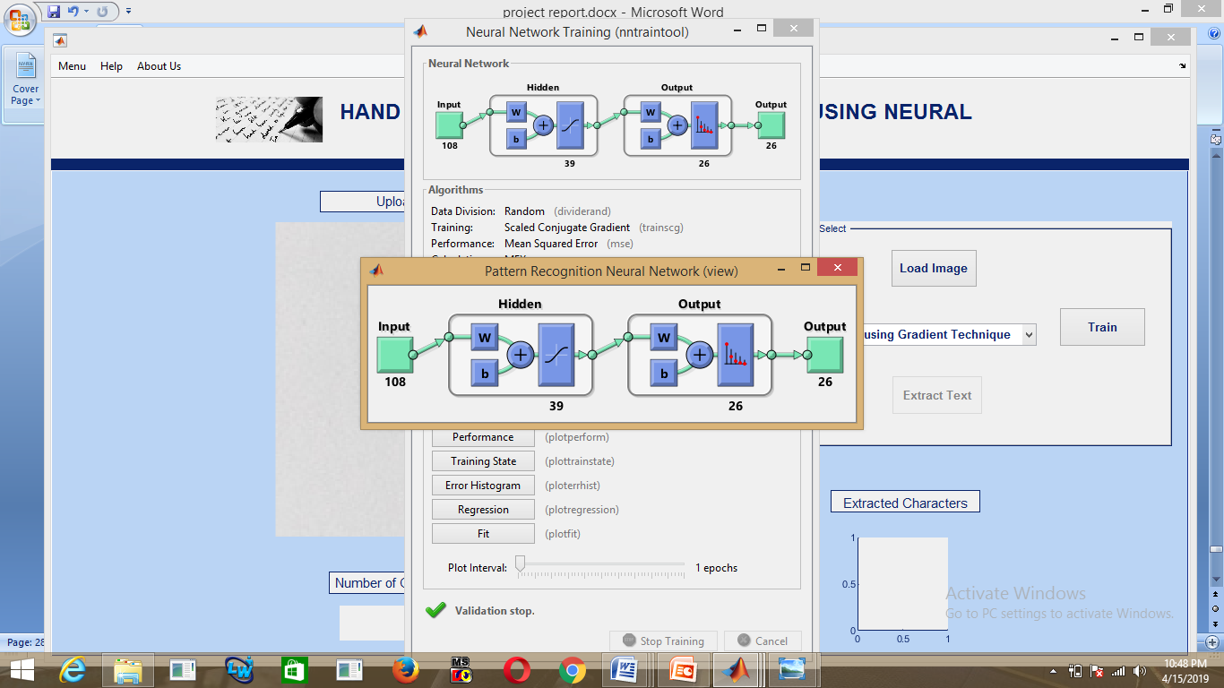
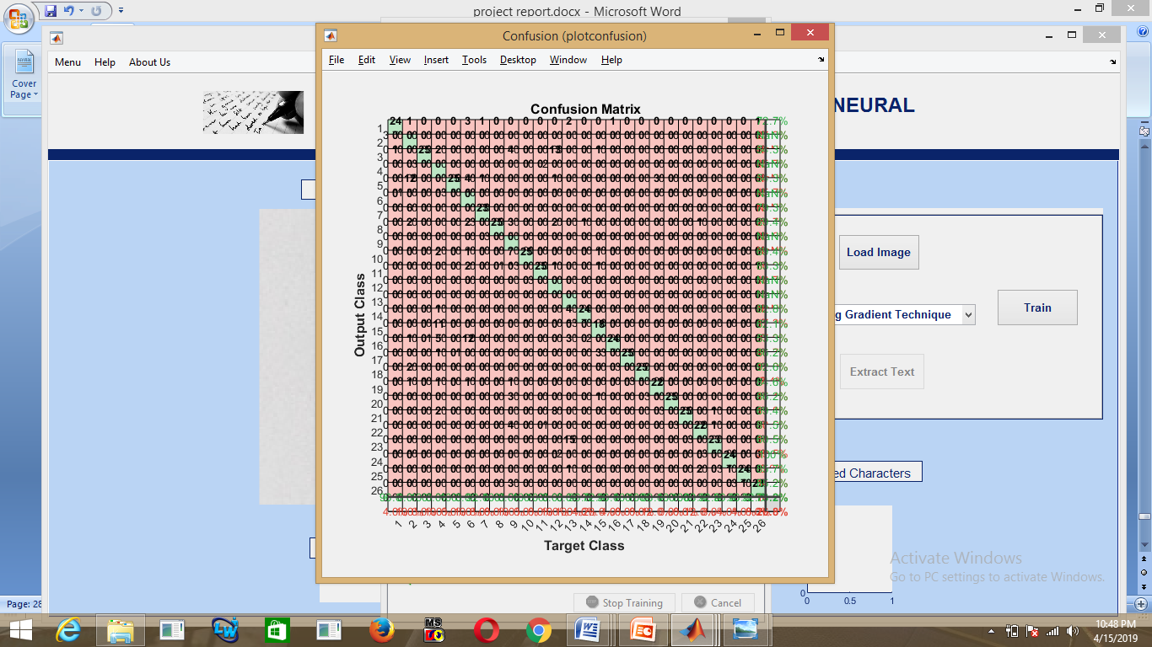
showing the network
generating confusion matrix

Slide 34
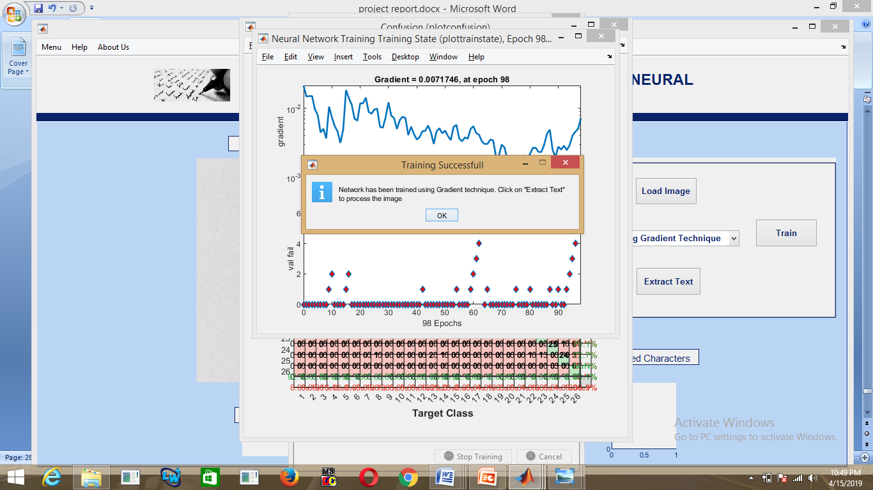
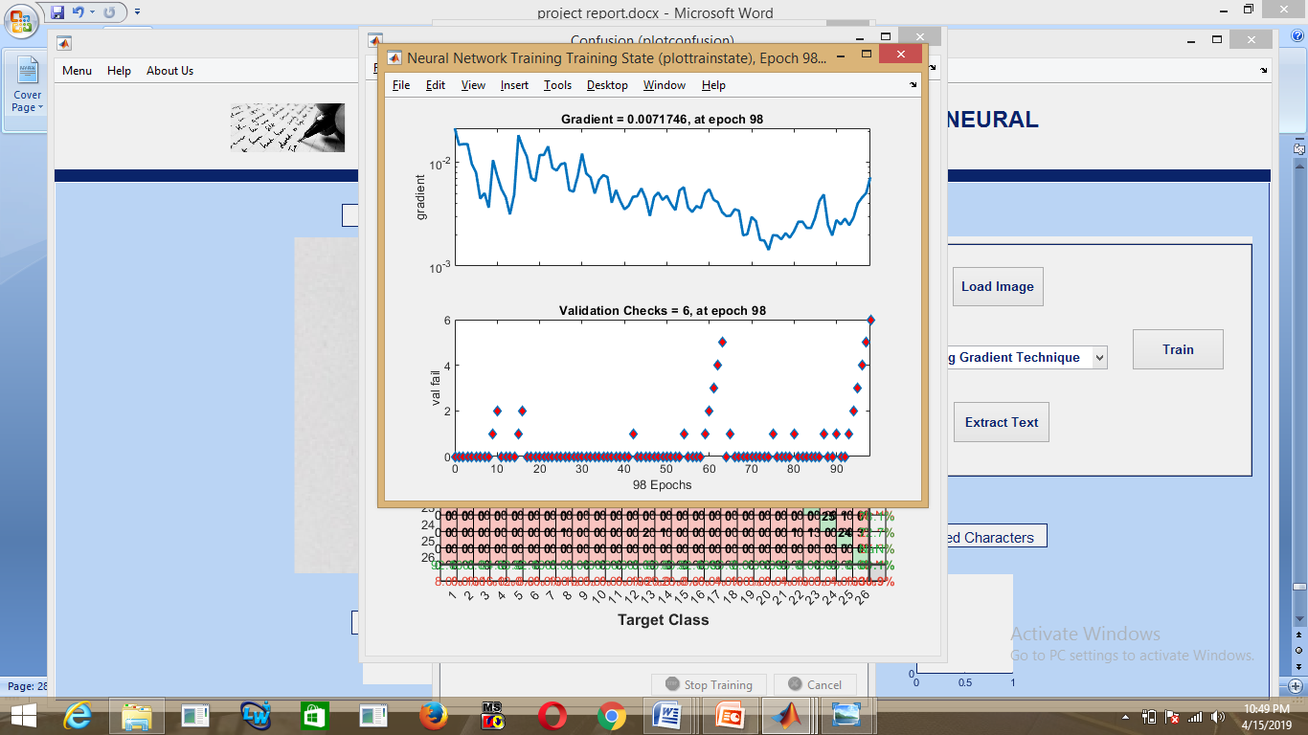
generating gradient vector
generating gradient

Slide 35
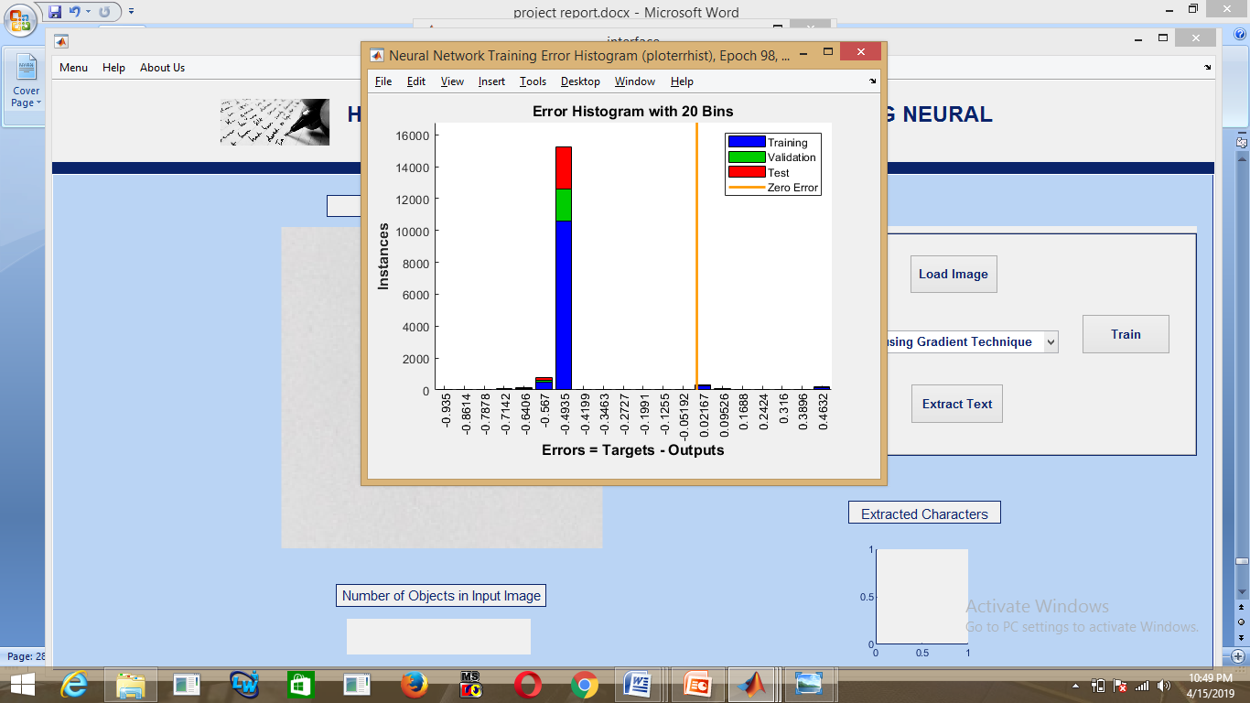
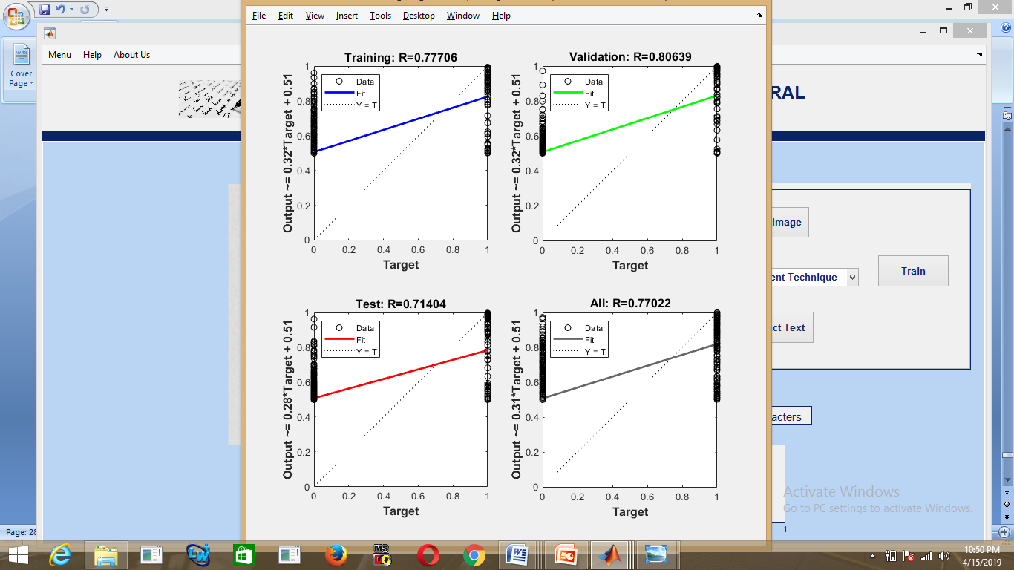
generating error histogram
graphs showing validation

Slide 36
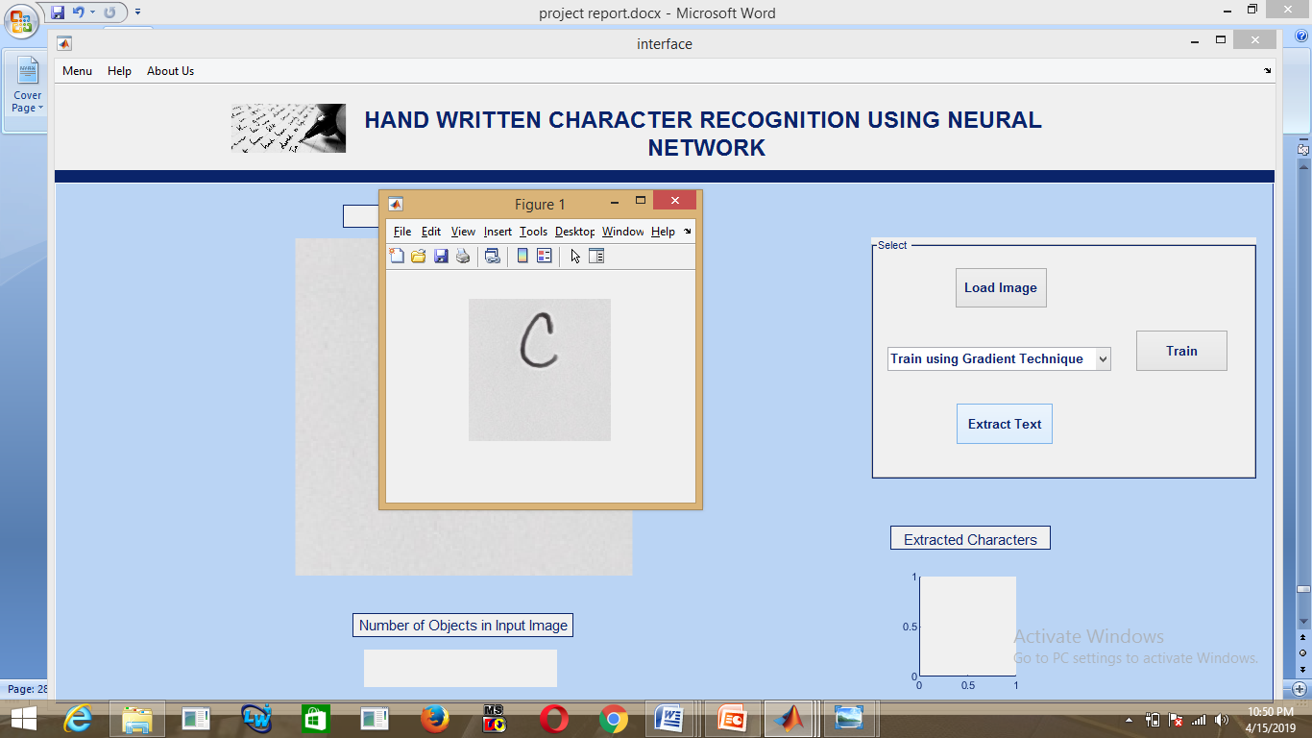

removing noise
removing noise

Slide 37
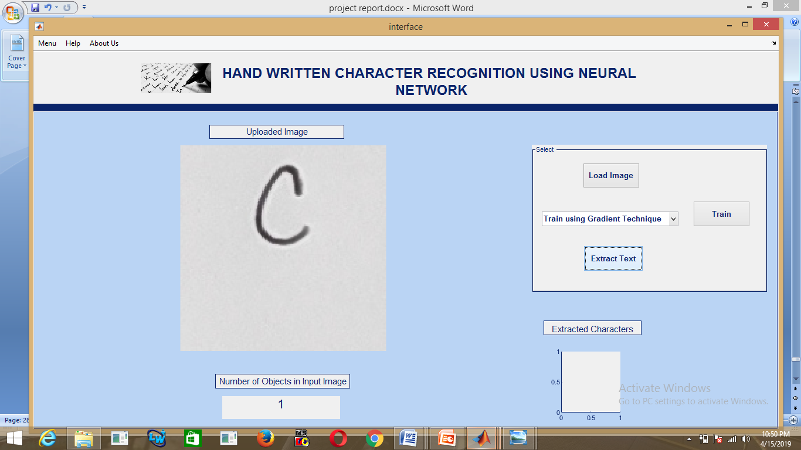
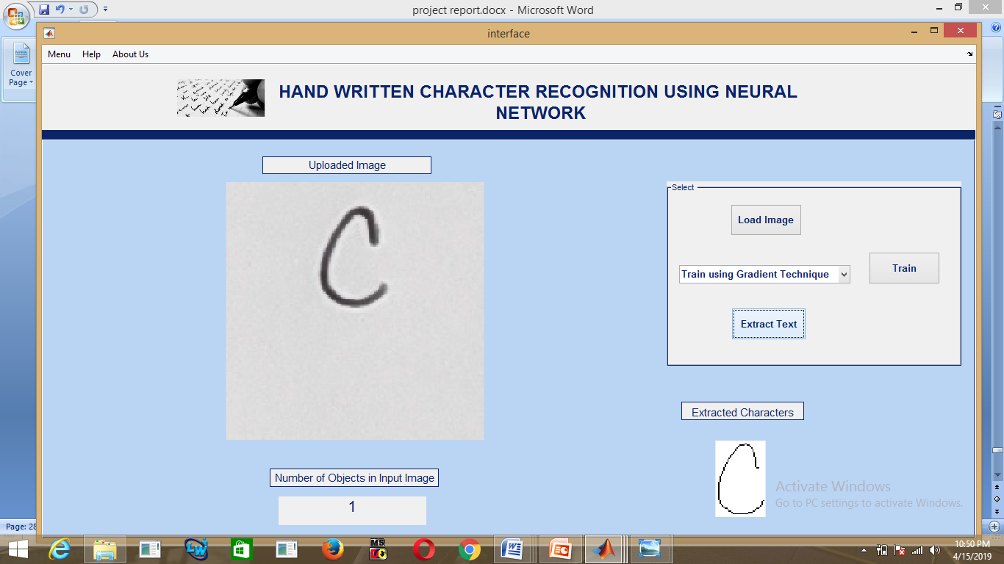
detecting no of characters
recognizing the character

Slide 38
Conclusion
We can get very good results using a very simple neural network model with a single hidden layer. In this section we will create a simple multi-layer perceptron model .We will use this as a baseline for comparing more complex convolutional neural network models. We can also use mobile phone screen as digitizers
In addition to the hardware technology more practical recognition algorithms have been developed
The CNN provide more accuracy than simple multilayered perceptron model
Our model provide error rate of 0.89% which uses MNIST dataset
And error rate of 1.74% when we use our own dataset

Slide 39
References
[1] K. Gaurav and Bhatia P. K., “Analytical Review of Preprocessing Techniques for Offline Handwritten Character Recognition”, 2nd International Conference on Emerging Trends in Engineering & Management, ICETEM, 2013.
[2] Ridhi Jindal, Dr.Sonia Vatra “Scale Invarient Transform", International Journal of Advance Research,Ideas And Innovations In Technology, Vol. 1, Issue 1, October 2014.
[3] Neha Sharma,Vibhor Jin,Anju Mishra, “An Analysis Of Convolutional Neural Network For Image Classification”, International Conference on Computational Intelligence and Data Science, 2018

Slide 40
Thank You

Slide 41
Feedback from the Panel
The panel wants the team to :

